Slide 1

Let’s Explore the Emergence of Artificial Intelligence Work Tools
National Community of Practice (CoP) series
July 11, 2023

Slide 2
Thank You for Joining us for Today’s
National Community of Practice Webinar
Our program will begin promptly at 3:00 p.m. EST. Until then, please sit back and enjoy the music!

Slide 3

Let’s Explore the Emergence of Artificial Intelligence Work Tools
National Community of Practice (CoP) series
July 11, 2023

Slide 4
Maximizing Your Webinar Participation:
Zoom Tips
  Audio Settings: You can change your audio settings. You can also click the upward arrow (^) next to the microphone icon at the lower-left of the Zoom window to change your speaker.
  Captioning: Available in a separate browser window by clicking the link to the following page on Captioned Text.
  Questions: If you have a question for today’s presenters, please type it in the Q&A box at any time during the presentation. Open the Q&A window, type in your question, and then press “send.” You will receive a response in the Q&A window, or the question will be answered live.

Slide 5
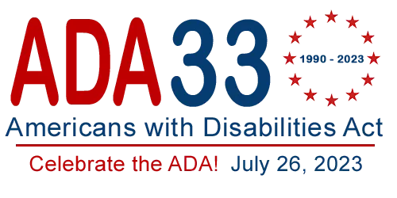
Celebrating the Anniversary of Americans with Disabilities Act!
Source: https://adaanniversary.org/logos/

Slide 6
Agenda
Welcome
Remarks from Leadership at the Administration for Community Living
Office of Disability Employment Policy, Partnership on Employment and Accessible Technology
Floreo
Question and Answer Session

Slide 7



Brief Speaker Introductions
David Jones
Nathan Cunningham
Vijay Ravindran
Notes:
Plus guest speakers from the CA State DD Council and the SC DD Council!

Slide 8
Remarks from Leadership at the Administration for Community Living
Welcome David Jones!

Slide 9

AI & Employment: Disability Lens
DETAC Webinar | July 11, 2023

Slide 10
KEY #1
Think before using AI.

Slide 11

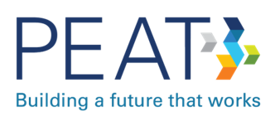
Hello!
I work on ODEP’s Technology Initiatives.
ODEP funds the Partnership on Employment & Accessible Technology (PEAT). PEAT helps workplaces use technology to foster inclusion.
Nathan Cunningham
Senior Policy Advisor
Office of Disability Employment Policy

Slide 12
Questions of the Day
1. What is AI?
2. How are people using AI?
3. How can we help?
Notes:
Contents

Slide 13
1. What is AI?
Artificial intelligence is a machine’s ability to do cognitive tasks associated with human minds: perceiving, learning, interacting, problem solving, and being creative.
13

Slide 14
AI can help, and AI can harm.arm.
KEY #KEY #2
KEY #2
14

Slide 15
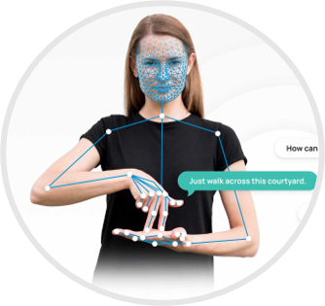
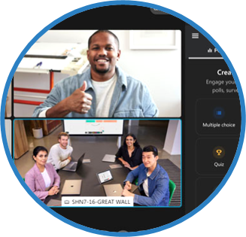

AI can assist with job tasks.
COMMUNICATION
Cognitive support (writing aids)
Speech transcription
COLLABORATION
Notetaking support and analysis
Chatbots
ASSISTIVE TECH
Computer vision (wayfinding, seeing assistance)
Sign language translators

Slide 16

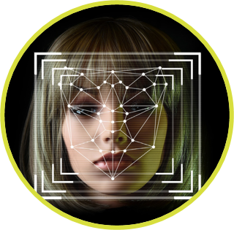

AI can make decisions about workers.
RECRUITING & HIRING
Job matching
Resume screening
Algorithmic interviews and tests
SURVEILLANCE
Productivity tracking
Ability-based monitoring (e.g., keyboard, gaze)
TRAINING
Job simulation (virtual reality)
Career development

Slide 17
2. How are people using AI?
The research on AI adoption is mixed. Some people want to use AI for employment tasks and decisions, and others are concerned.
17

Slide 18
Key #4
KEY #3
AI only exists because people build and use it.
18

Slide 19
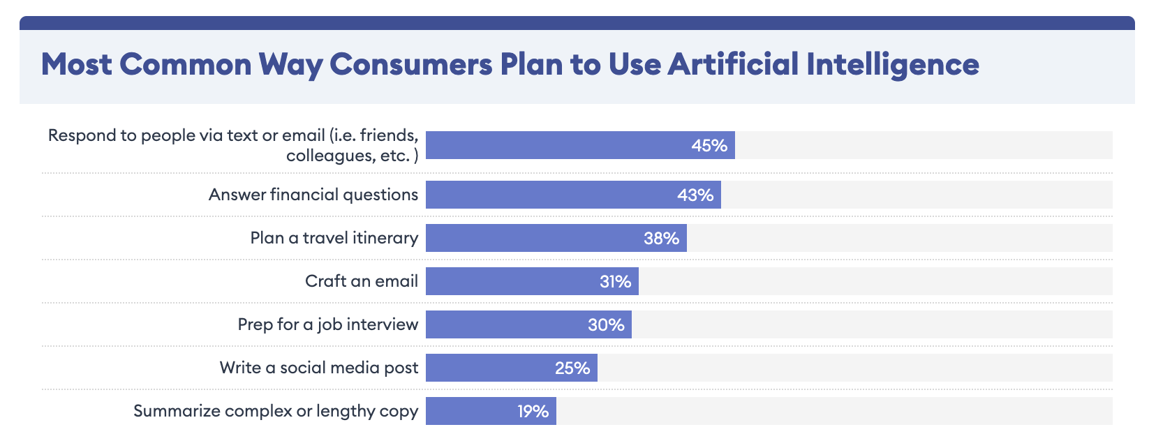
Figure 1: Consumer Adoption
45% of consumers plan to use AI to respond to texts and emails, while 30% plan to use AI to prep for job interviews.
Source: Survey on Consumer Opinions about AI, Forbes Advisor (2023)

Slide 20
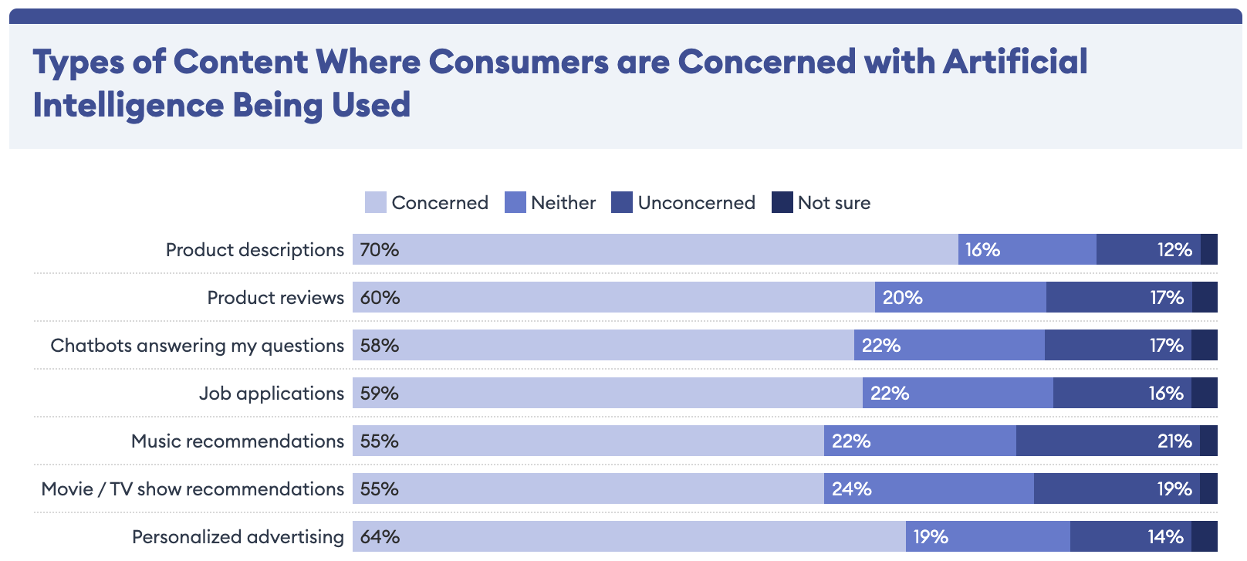
Figure 2: Consumer Concerns
Many consumers are concerned about businesses using AI. For example, 59% are concerned about AI in job applications.
Source: Survey on Consumer Opinions about AI, Forbes Advisor (2023)

Slide 21
Key #4
KEY #4
AI is impacting employment decisions.

Slide 22
Research: HR Adoption (1 of 3)
The largest organizations are more likely to use AI to support HR-related activities
Nearly 1 in 4 organizations use AI to support HR-related activities.
42%
26%
24%
16%
Extra-large organizations (5,000+
employees)
Large organizations (500-4,999
employees)
Medium organizations (100-499
employees)
Small organizations (2-99
employees)
Source: Using Artificial Intelligence for Employment Purposes, Society for Human Resource Management (2022)

Slide 23
Research: HR Adoption (2 of 3)
How organizations use automation or AI to support recruiting and hiring activities
*Question was select all that apply.
64%
To communicate with applicants during the interview process
69%
64% of HR professionals say their organization’s automation or AI tools automatically filter out unqualified applicants.
To review or screen applicant resumes
64%
To automate candidate searches
52%
To customize or target job postings to specific groups
42%
To pre-select applicants for interviews
25%
38%
To administer and score applicant skills assessments
22%
To generate job descriptions
17%
38% of HR professionals say their organization’s automation or AI tools provide a percentage match or ranking for each applicant.
To administer automated interviews and analyze responses
6%
Source: Using Artificial Intelligence for Employment Purposes, Society for Human Resource Management (2022)

Slide 24
Research: HR Adoption (3 of 3)
92%
of organizations that use automation or AI to support HR-related activities source some or all of these tools directly from a vendor.
Only 2 in 5
organizations that purchase automation or AI tools from vendors say their vendor(s) are very transparent about the steps taken to ensure the tools prevent or protect against discrimination or bias.
Source: Using Artificial Intelligence for Employment Purposes, Society for Human Resource Management (2022)

Slide 25
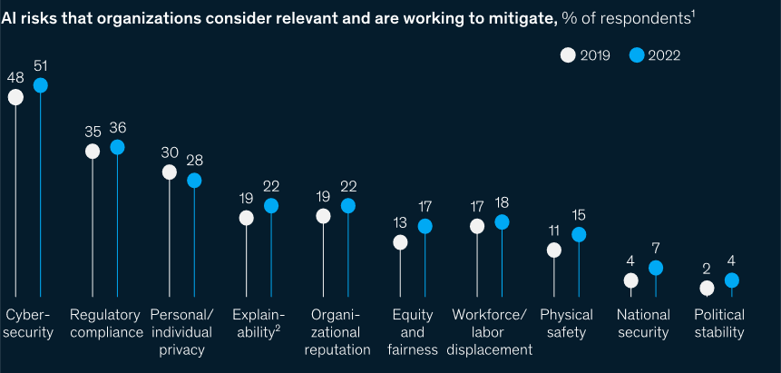
Figure 5: AI Risk Management
From 2019 to 2022, organizations did not report a substantial increase in their efforts to mitigate AI risks.

Slide 26
Key #5
KEY #5
Employers need help with AI governance.
26

Slide 27
3. How can we help?
We have a duty to help make AI tools fair for people with disabilities.
27

Slide 28




Pictures of People with Disabilities at Work

Slide 29

ODEP Strategy
  Influence federal policies
  Engage civil society leaders
  Create employer resources and partnerships

Slide 30




Influence Federal Policies
White House Office of Science & Technology Policy
  Blueprint for an AI Bill of Rights & Fact Sheet (Oct. 2022)
  RFI on Worker Surveillance (May 2023)
Federal Authorities
  EEOC Guidance on the ADA and AI Hiring Tech (May 2022)
  Joint Statement on Enforcement Efforts Against Discrimination and Bias in Automated Systems (April 2023)
  OFCCP Fairness in Technology Task Force (Ongoing)
  DOL AI Equity Workgroup (Ongoing)
National Institute of Standards & Technology (NIST)
  SP 1270: Towards a Standard for Identifying and Managing Bias in AI (2021)
  AI Risk Management Framework (RMF) & Playbook (Jan. 2023)
  PEAT Think Tank to Apply AI RMF to Hiring (April 2023)
Notes:
EEOC
- Input regarding disability equity considerations in tech-based hiring systems; helped shape EEOC guidance on ADA and Use of Software, Algorithms, AI to Assess Job Applicants & Employees (first-of-a-kind guidance from fed agency)
NIST
- Inputs related to disability bias mitigation, nondiscrimination, and accessibility
- PEAT Think Tank planned (April 2023) in collaboration with NIST to launch a community effort to develop specific AI RMF Profile for automated employment decision tools (see attached overview)

Slide 31


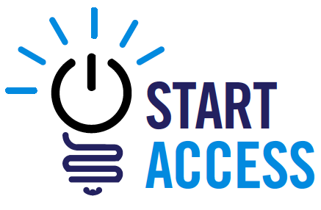



Engage Civil Society Leaders
Center for Democracy & Technology (CDT)
  Report on Disability Discrimination in Surveillance Tech (May 2022)
  Collaborative Model Standards for Fairness in AI Hiring Tech
  (Dec. 2022)
American Association of People with Disabilities (AAPD)
  Start Access Initiative on Inclusive Hiring Tech (Ongoing)
ForHumanity
  Independent Audit of AI Systems (Ongoing)
  Audit Certification on Disability Inclusion & Accessibility (Mar. 2023)
Data & Society
  Public Technology Leadership Collaborative (Ongoing)
  Non-extractive participatory engagement
Notes:
- Helped launch and advise AAPD’s Start Access Initiative, focused on disability inclusion and accessibility of AI-enabled hiring technology
- For Body of Knowledge, suggest links to PEAT’s published resources, also W3C resources like WCAG Conformance, WCAG Testing Methodology

Slide 32
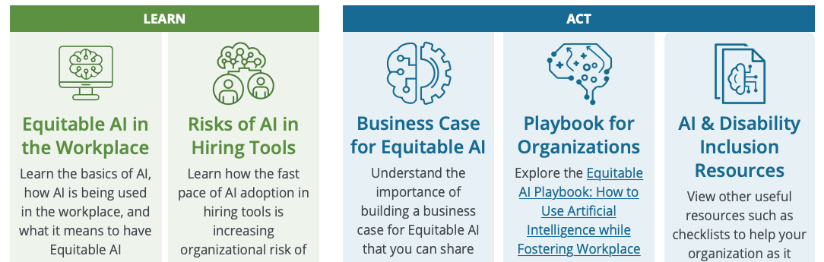




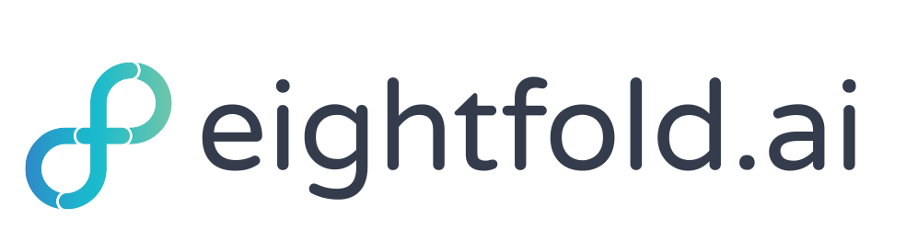
Create Employer Resources
AI & Disability Inclusion Toolkit (Oct. 2021)
Disability-Led Innovation Report (Nov. 2022)
Automated Surveillance Articles (Jan. 2023)
Presentations at CSUN, SXSW,
IAAP, M-Enabling Summit, SHRM, and more
ODEP tech demos for
Federal Tech Day 2023

Slide 33
Keys for Ethical AI
THE KEYS TO AI GOVERNANCE
Think before using AI.
AI can help, and AI can harm.
AI only exists because people build and use it.
AI is impacting employment decisions.
Employers need help with AI governance.
And…
33

Slide 34
Final Key
FINAL KEY
AI governance means we set policies to decide what comes next.
34

Slide 35
Thank You
Nathan Cunningham
Cunningham.Nathan@dol.gov
35

Slide 36
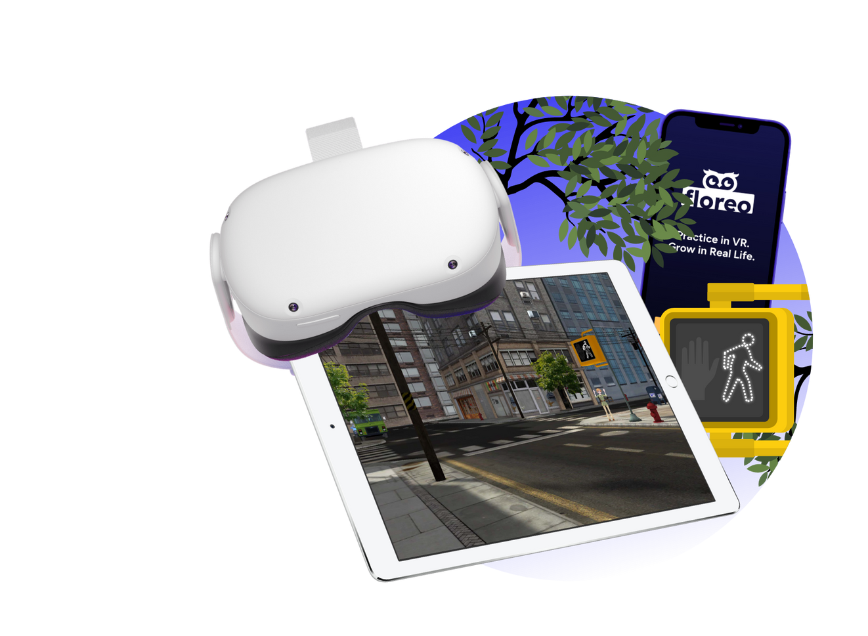
Floreo VR
Vijay Ravindran
July 11, 2023

Slide 37
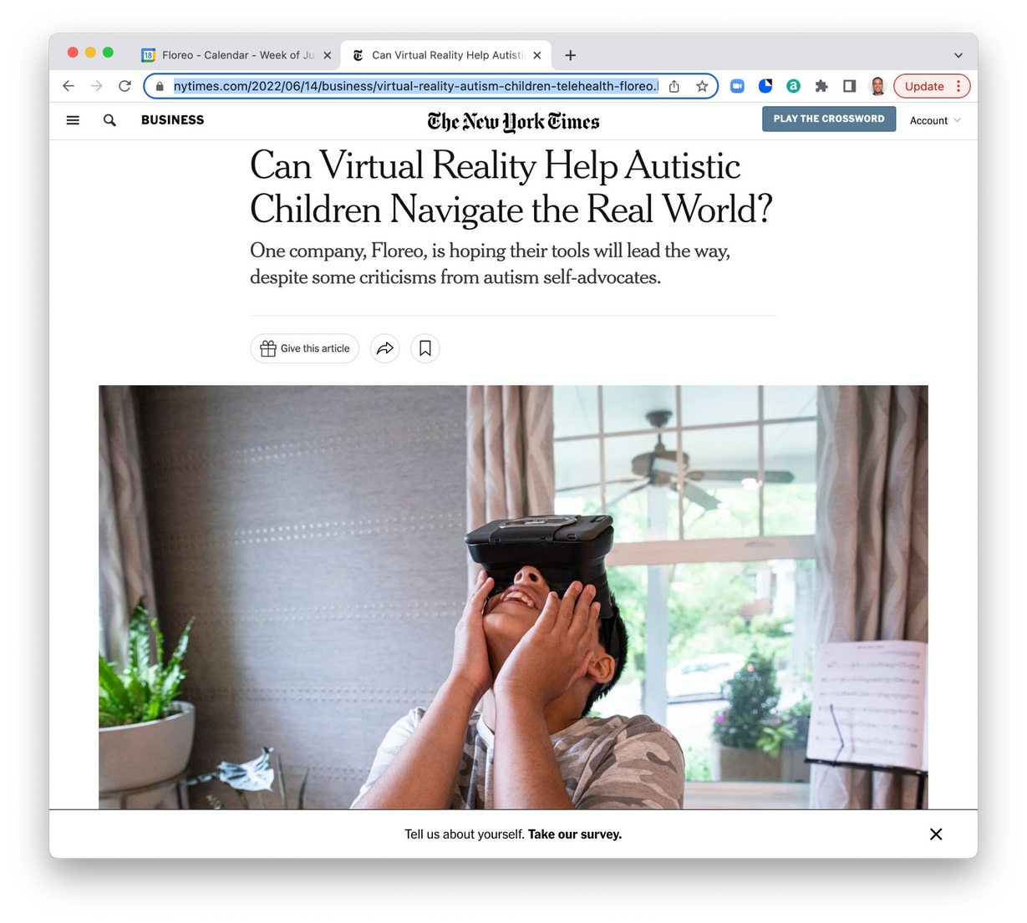
VR for Autism
  Founded by Amazon veteran Vijay Ravindran
  Inspired by his son’s first experience with VR
  Today a patented research-backed telehealth-ready therapy system

Slide 38


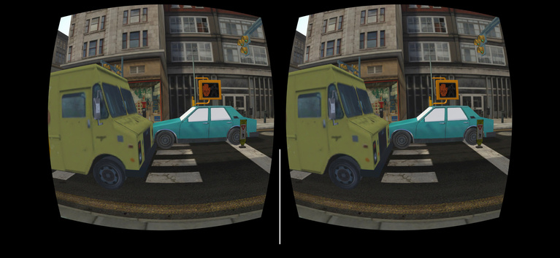

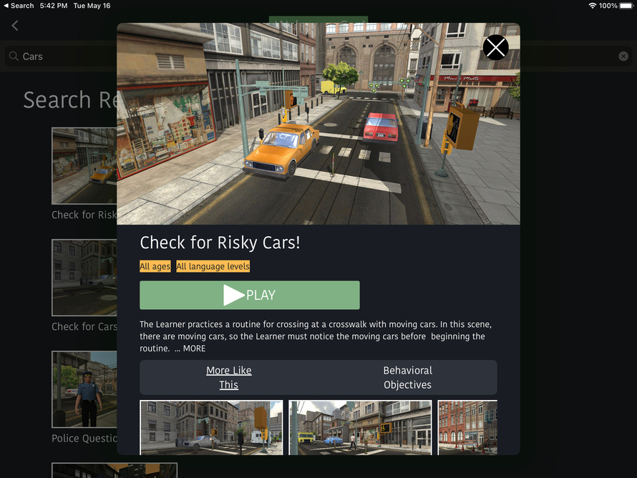
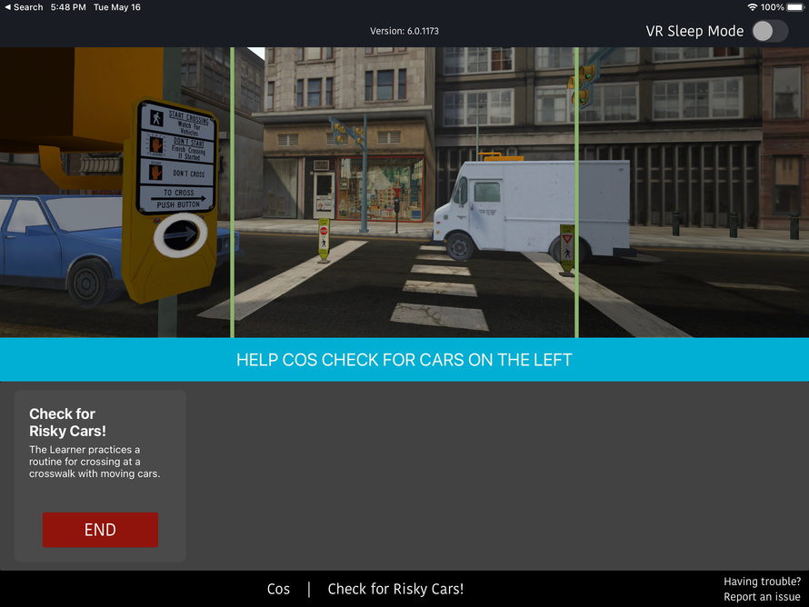
How It Works
Learners view Floreo platform via mobile VR headset
Coaches (e.g., therapists) choose Floreo learning module and view what the child is seeing via tablet or iPad
Learners interact in Floreo VR world and learn essential life skills, like how to cross the street

Slide 39
Demo

Slide 40
Opportunities for AI
Intelligent Characters
Automated Coaching
Personalized Environments
Tailored Lesson Plans

Slide 41

Question and Answer Session
We want to hear from you!
Please type a question in the chat box and we will try our best to answer!
Notes:
Note, image was derived from the stock images of the PPT.

Slide 42

DETAC offers free technical assistance!
Submit your request to the:
on-demand TA request page
Reach out by emailing: AoDemploymentTA@gmail.com

Slide 43

DETAC Contact Information
Email:
AoDemploymentTA@gmail.com
Website:
https://aoddisabilityemploymenttacenter.com
DETAC Publications:
https://aoddisabilityemploymenttacenter.com/detac-publications/
thanks for
stopping by!

