Slide 1
Evaluating Employment Outcomes in Diverse Communities: Lessons Learned from Community Collaborations for Employment (CCE) Grantees in Texas and Virginia
National Community of
Practice Series
August 14, 2023

Slide 2
Thank You for Joining us for Today’s National Community of Practice Webinar
Our program will begin promptly at 4:00 p.m. EDT. Until then, please sit back and enjoy the music!

Slide 3
Evaluating Employment Outcomes in Diverse Communities: Lessons Learned from Community Collaborations for Employment (CCE) Grantees in Texas and Virginia
National Community of
Practice Series
August 14, 2023

Slide 4
Maximizing Your Webinar Participation: Zoom Tips
Audio Settings: You can change your audio settings. You can also click the upward arrow (^) next to the microphone icon at the lower-left of the Zoom window to change your speaker.
Captioning: Available in a separate browser window by clicking the link to the following page on Captioned Text.
Questions: If you have a question for today’s presenters, please type it in the Q&A box at any time during the presentation. Open the Q&A window, type in your question, and then press “send.” You will receive a response in the Q&A window, or the question will be answered live.

Slide 5
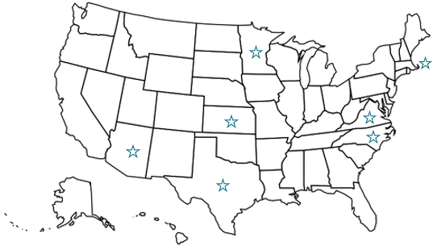
CCE Grant Overview
In 2021, the Administration for Community Living awarded the Community Collaborations for Employment (CCE) grant to seven grantees to help increase and enhance collaborations across systems to maximize a seamless experience for youth with intellectual and developmental disabilities as they transition between school and work in the community.

Slide 6
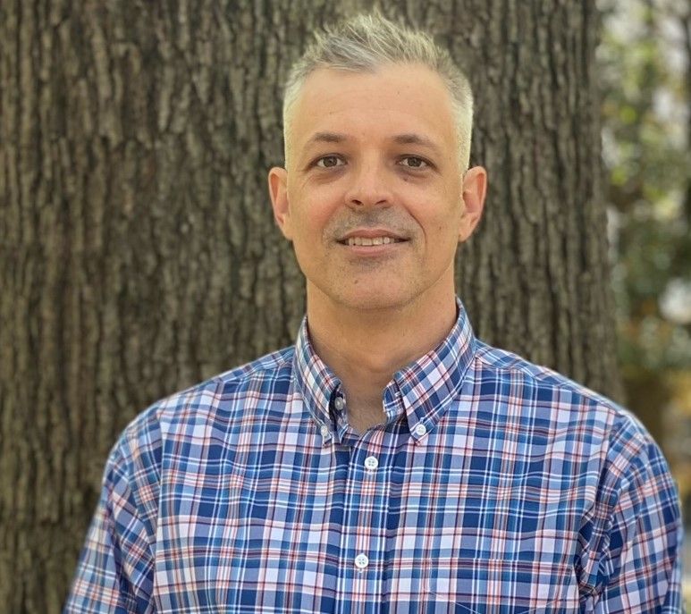
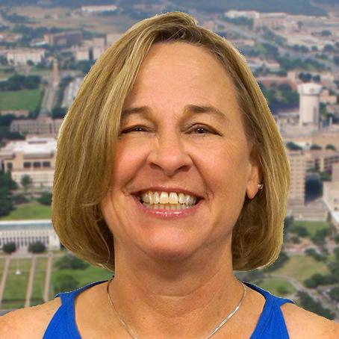
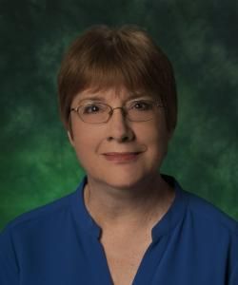
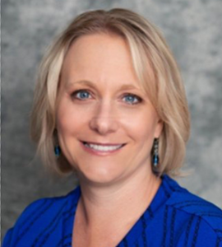
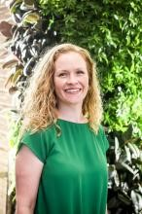
Speaker Introductions
Seb M. Prohn, PhD
Assistant Director- Research & Evaluation
Partnership for People with Disabilities
Virginia Commonwealth University
Cheryl Grenwelge, PhD
Associate Professor
Texas A&M AgriLife Extension
Denise Catalano, PhD, CRC
Associate Professor, Rehabilitation Counseling
RSA Scholarship Project Director
University of North Texas
Peggy Schmidt
Program Administrator
Supported Employment
LifePath Systems
Lucy Gafford, MS, CRC, CESP
Director
UNT WISE

Slide 7
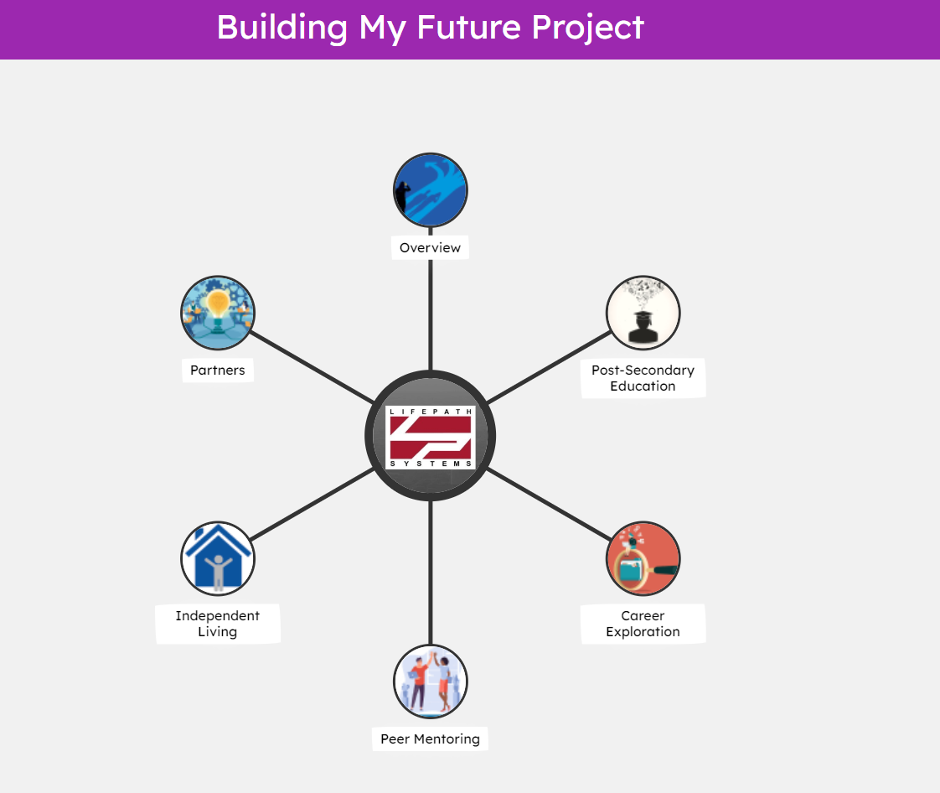
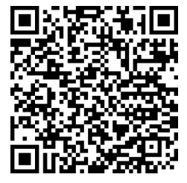
Texas CCE Grant Overview
To create and sustain a coordinated, collaborative transition system in Collin County that will increase the number of youths with ID/DD who pursue and achieve post secondary education, career and independent living aspirations of their choice.
Cognitopia

Slide 8
Virginia CCE Grant Overview
Community Expertise
Intentional co-powering that includes attention to
Grounded wisdom & lived experience
Readiness: their timeline & comfort
Bottom-up control & knowledge creation
Diverse perspectives & strength
The goal is for communities to identify strengths and needs and collaboratively build solutions for community employment

Slide 9
Virginia CCE Grant: Community of Focus

Slide 10
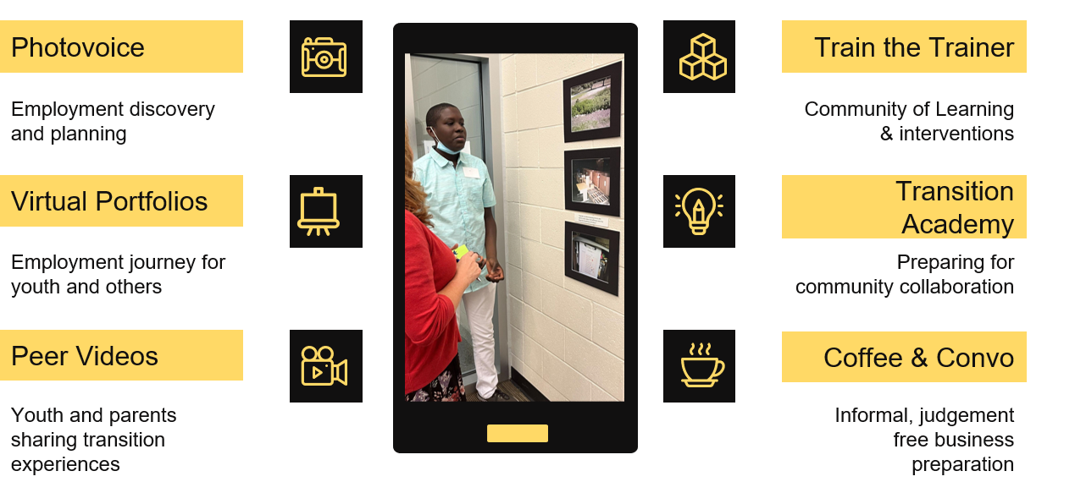
Virginia CCE Grant: Growing Community Capacity

Slide 11
Panel

Slide 12
How are you defining and measuring success? How did you build evaluation into your implementation plan?

Slide 13
How did you incorporate cultural and linguistic considerations of your community of focus into your evaluation plan?

Slide 14
What are the challenges of evaluating an employment program? What strategies have you used to address those challenges?

Slide 15
What advice related to evaluation would you share with a colleague who is launching or running and employment program?

Slide 16
Question and Answer Session
We want to hear from you!
Please type a question in the chat box and we will try our best to answer!
Notes:
Note, image was derived from the stock images of the PPT.

Slide 17
Upcoming Webinar
September 19, 2023: 3:00 - 4:00 PM EST
Title: Let’s Commemorate the Rehab Act: The Power of Independent Living & Employment
Elements:
Overview of NCIL
Explanation of the role of CILs, CIL networks, partnerships, and how CILs can help
Examples discussed: transition from nursing homes to community living and then to employment, tapping into the DSP shortage crisis, ensuring that every person is the central focus of their planning to maintain consumer choice and control.
A deeper dive into resource gaps and creative strategies CILs are implementing to support community living and CIE
NCIL will discuss how to connect with CILs. For example, if there is another grantee or a state person that wants to partner with a CIL – how do they find the CIL? Who should they talk to?
Register Here: https://bit.ly/DETAC-CoP-Sep-19-2023

Slide 18
DETAC offers free technical assistance!
Submit your request to the: on-demand TA request page
Reach out by emailing: AoDemploymentTA@gmail.com

Slide 19
DETAC Contact Information
Email: AoDemploymentTA@gmail.com
Website: https://aoddisabilityemploymenttacenter.com
DETAC Publications: https://aoddisabilityemploymenttacenter.com/detac-publications/
thanks for
stopping by!

