Slide 1
Let’s Commemorate the Rehabilitation Act of 1973: The Power of Independent Living and Employment
National Community of Practice (CoP) series
September 19, 2023

Slide 2
Thank You for Joining us for Today’s National Community of Practice Webinar
Our program will begin promptly at 3:00 p.m. EST. Until then, please sit back and enjoy the music!

Slide 3
Let’s Commemorate the Rehabilitation Act of 1973: The Power of Independent Living and Employment
National Community of Practice (CoP) series
September 19, 2023

Slide 4
Maximizing Your Webinar Participation: Zoom Tips
Audio Settings: You can change your audio settings. You can also click the upward arrow (^) next to the microphone icon at the lower-left of the Zoom window to change your speaker.
Captioning: Available in a separate browser window by clicking the link to the following page on Captioned Text.
Questions: If you have a question for today’s presenters, please type it in the Q&A box at any time during the presentation. Open the Q&A window, type in your question, and then press “send.” You will receive a response in the Q&A window, or the question will be answered live.

Slide 5
Agenda
Welcome
National Council on Independent Living (NCIL)
Regional Access and Mobilization Project (RAMP) Center for Independent Living
Question and Answer Session

Slide 6
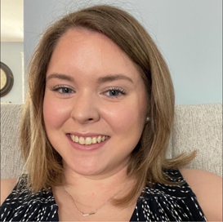
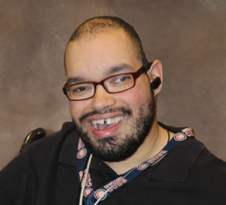
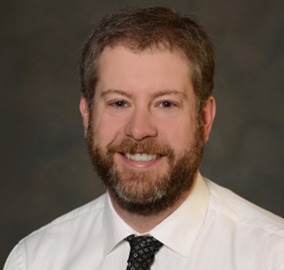
Brief Speaker Introductions
Mary-Kate Wells
Ron Jackson
Jeremy Munson
Notes:
Plus guest speakers from the CA State DD Council and the SC DD Council!

Slide 7
National Council on Independent Living
The National Council on Independent Living (NCIL) is the longest-running national cross-disability, grassroots organization run by and for people with disabilities.

Slide 8
What is Independent Living?
A Program
A Movement
A Culture/Philosophy
The Independent Living Movement and Centers aim to maximize the leadership, empowerment, independence, and productivity of individuals with disabilities, and the integration and full inclusion of individuals with disabilities into the mainstream of American society.

Slide 9
Centers for Independent Living (CILs)
Centers for Independent Living are consumer- controlled, community-based, cross-disability, nonresidential private nonprofit agency for individuals with significant disabilities (regardless of age or income).

Slide 10
Centers for Independent Living (CIL): Core Services
Information and Referral Services
Independent Living Skills Training
Peer Counseling
Individual and Systems Advocacy
Transition
Transition back into the community,
Assistance to stay in the community,
Transition of youth to postsecondary life

Slide 11
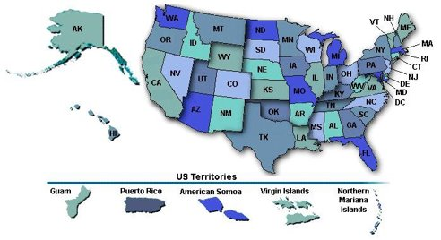
Connecting with your local CIL: CIL/SILC Directory
http://www.ilru.org/html/publications/directory/index.html

Slide 12
Disability-led and Consumer Control
Nothing about Us without Us!
People with disabilities are the best experts on their own needs.
People with disabilities have the right to make choices and to control the decisions in their lives.
People with disabilities deserve equal opportunity to decide how to live, work, and take part in their communities, particularly in reference to services that powerfully affect their day-to-day lives and access to independence.

Slide 13
Commemorating the Rehab Act: The Power of Independent Living and Employment
Access and equity
Building up the next generation of disability leaders
Strengthen and expand the IL Network
Address systemic ableism
Notes:
Moving forward

Slide 14
Employment Services RAMP CIL
PRESENTED BY: JEREMY MUNSON & RON JACKSON

Slide 15
Agenda
Brief history of RAMP & RAMP’s Employment Services
Ticket to Work
DRS/VR – milestone competitive employment
Project SEARCH

Slide 16
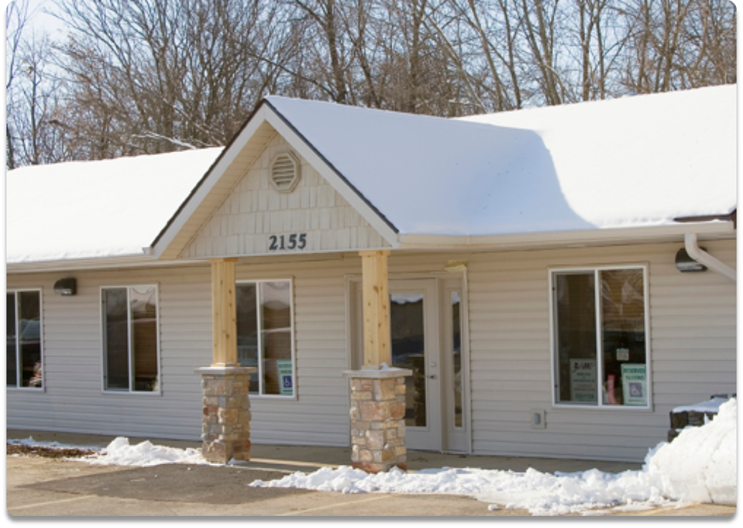
About RAMP CIL
Started in 1980
2nd CIL in Illinois
Provide services to 4 counties in Northern Illinois
Boone, DeKalb, Stephenson, & Winnebago
TTW program serves the entire state*
Building an inclusive community that encourages individuals with disabilities to reach their full potential.

Slide 17
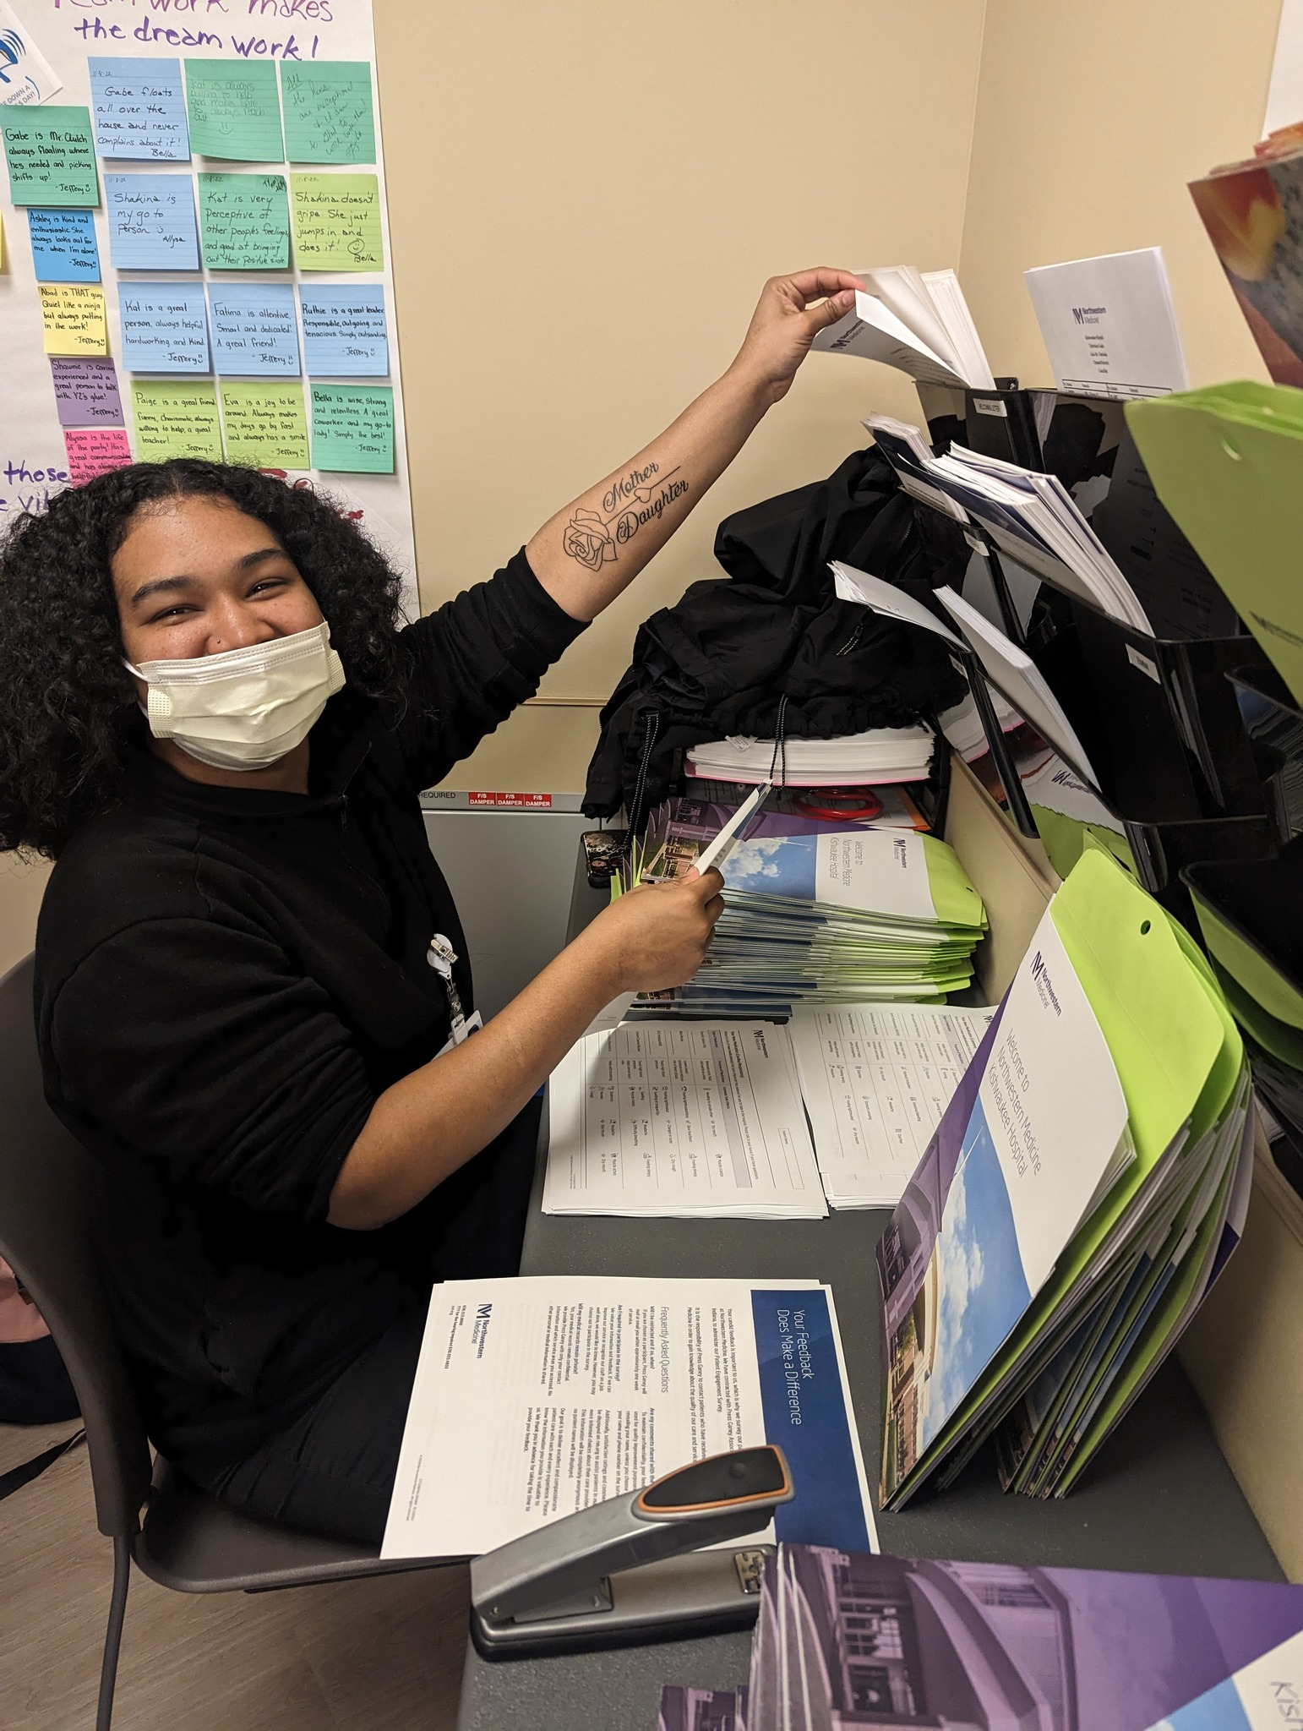
History of Employment Services
Launched in September 2012
Goal—Any individual with a disability who wants to work is employed.
RAMP’s Employment Services now consists of 3 programs that exist to place consumers in jobs:
Ticket To Work
DRS/VR—Milestone
Project SEARCH
As of January 2023
139 TTW placements
200 DRS/VR placements
69 Project SEARCH placements

Slide 18
Why would a CIL choose to provide Employment Services?
Through our internal strategic planning, the following findings were made:
A high % of consumers coming to RAMP had unmet vocational desires.
Other local providers could not meet the demand or provided low quality, non-consumer driven services.
What we did with these findings:
For more than a year, RAMP identified and worked with providers nation-wide to develop a process that we believed would lead to successful outcomes
The success of our early participants strengthened our desire to build up these programs and empower consumers to become more self-sufficient. *Consumers were reporting that they felt an improvement to their quality of life!
Many bumps in the road that we learned from and made adjustments to improve.

Slide 19
Ticket to Work
Contract thru Social Security Administration
Certified Work Incentive Counselor (CWIC)
As the individual begins to receive earnings by working, funding shifts to RAMP.
1/10th of 1% of ticket holders utilize the TTW option.

Slide 20
DRS/VR—Milestone Competitive Employment
Contract through the State of Illinois-Dept. of Rehab Services (VR) program.
Milestone payments are reached at 15, 45, and 90 days of employment.
This program is ideal for individuals who are not receiving SSI/SSDI or who do not wish to end their SSI/SSDI benefits.
This program provides counseling and prep work to get a job. NOT on-the-job training.

Slide 21
Project SEARCH
First site opened in 2017.
Collaboration between RAMP, local school districts, a host business, and the State of Illinois.
RAMP is now a partner at 3 PS sites!
Paid for through the State of Illinois Dept. Of Rehab Services (VR) and Fundraising/Development.
High rates of success for youth that traditionally have very low rates of employment after leaving high school.

Slide 22
Question and Answer Session
We want to hear from you!
Please type a question in the chat box and we will try our best to answer!
Notes:
Note, image was derived from the stock images of the PPT.

Slide 23
Upcoming Webinar- Advancing Access and Equity for People with Disabilities through Technology, Celebrating National Disability Employment Awareness Month
October 10, 2023: 3:00 - 4:00 PM EST
Presenters: Regina ‘Gina Kline/Enable Ventures and Ohio State University Nisonger Center
Register: https://bit.ly/DETAC-CoP-Oct-10-2023

Slide 24
New Results in Systems Excellence (RISE) eLearning Community: Strategies to Phase-Out 14(c) for all Grantees
Facilitated by: The National Disability Rights Network
Session Dates:
Session One: October 19: 2:00-3:30PM/ET
Session Two: November 16 from 2:00-3:30PM/ET
Session Three: December 21 from 2:00-3:30PM/ET
Session Four: January 18 from 2:00-3:30PM/ET
Session Topics:
Policy and legislative efforts
Alternatives to 14(c) (e.g., E1st, discovery, VR, other options)
Self-advocacy and messaging
Systems change
Space is limited – Apply Here: https://forms.gle/z5g7DxzZ36NtzySn7

Slide 25
DETAC offers free technical assistance!
Submit your request to the: on-demand TA request page
Reach out by emailing: AoDemploymentTA@gmail.com
Reach out!

Slide 26
DETAC Contact Information
Email: AoDemploymentTA@gmail.com
Website: https://aoddisabilityemploymenttacenter.com
DETAC Publications: https://aoddisabilityemploymenttacenter.com/detac-publications/
thanks for
stopping by!

