Slide 1
Advancing Access and Equity for People with Disabilities through Innovations in Technology
National Community of Practice (CoP) series
October 10, 2023

Slide 2
Thank You for Joining us for Today’s National Community of Practice Webinar
Our program will begin promptly at 3:00 p.m. EST. Until then, please sit back and enjoy the music!

Slide 3
Advancing Access and Equity for People with Disabilities through Innovations in Technology
National Community of Practice (CoP) series
October 10, 2023

Slide 4
Maximizing Your Webinar Participation: Zoom Tips
Audio Settings: You can change your audio settings. You can also click the upward arrow (^) next to the microphone icon at the lower-left of the Zoom window to change your speaker.
Captioning: Available in a separate browser window by clicking the link to the following page on Captioned Text.
Questions: If you have a question for today’s presenters, please type it in the Q&A box at any time during the presentation. Open the Q&A window, type in your question, and then press “send.” You will receive a response in the Q&A window, or the question will be answered live.

Slide 5
Agenda
Welcome
Regina Kline
Human Development Institute, University of Kentucky
Question and Answer Session

Slide 6
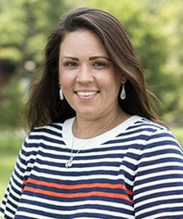
Brief Speaker Introductions
Regina ‘Gina’ Kline
Kathy Sheppard-Jones
Christina Espinosa
Notes:
Plus guest speakers from the CA State DD Council and the SC DD Council!

Slide 7
Regina Kline
Founder & Managing Partner, Enable Ventures
Founder & Chair, SmartJob
For more information, please visit:
Enable Ventures, https://www.enableventures.vc/
SmartJob, https://www.smartjob.net
Follow SmartJob and Enable Ventures on LinkedIn.

Slide 8
Human Development Institute, University of Kentucky

Slide 9
Human Development Institute
Driver Rehabilitation Program
10/10/2023

Slide 10
Human Development Institute Identities
Kentucky’s University Center on Disability (UCD)
Kentucky’s University Center for Excellence in Developmental Disabilities (UCEDD)
Kentucky’s Leadership Education in Neurodevelopmental and Related Disabilities (LEND)
Funded through a variety of grants and contracts, including our core grant that provides the framework of our organization
Part of the Developmental Disability Network, along with the Commonwealth Council on Developmental Disabilities and Kentucky Protection and Advocacy
Housed under Research at UK
A cross disability organization

Slide 11
Human Development Institute
71 projects
350 staff
8 student Research Assistants
20 member Consumer Advisory Council
23 Affiliate Faculty

Slide 12
What We Do
We have six priority areas
Employment
Early Care and Education
Leadership and Self-Advocacy
Research and Evaluation
Health
Universal Design and Assistive Technology

Slide 13
Independence Place and HDI CATS
Funding opportunities
Shared Space with HDI Center for Assistive Technology Services (CATS)
Mutually beneficial
Cross Referral of community members
Ability to distribute devices and medical equipment on site
Shared space costs

Slide 14
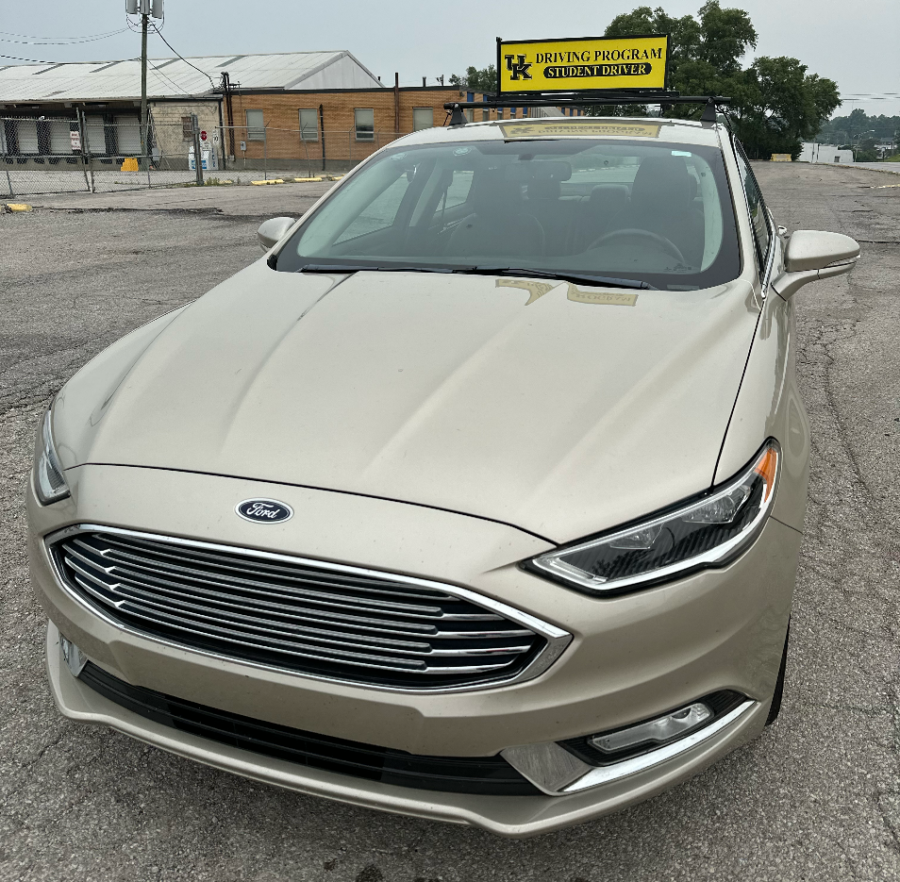
HDI Driving Program
Since 2012 HDI has coordinated the Driver Rehabilitation Evaluation and Training Program for OVR
HDI supplies assistive technology and rehabilitation engineering to individuals with disabilities, their families, and providers throughout the state
Collaborate with UK Healthcare Outpatient Services, who fund two positions for Occupation Therapists who are Certified Driver Rehabilitation Specialist (CDRS)
Directly support two additional CDRS’
Notes:
Driver rehabilitation is a service that evaluates and improves a person with a disability's function and independence behind the wheel. It is usually performed by a Certified Driver Rehab Specialist (CDRS) or Occupational Therapist (OT) who has the skills to assess the physical, mental, and cognitive abilities of drivers.

Slide 15
Kentucky Driver Rehabilitation Data
Office of Vocational Rehabilitation (OVR) Consumers who received:
driver evaluation
driver training
vehicle modification repair
vehicle modifications
Cases Closed - Successful Competitive Employment
2019 - 91%
2020 – 66%
2021 - 65%
2022 – 60%
Notes:
The decreases shown between 2020 – 2022 reflect the unsettled nature of employment during the pandemic and post-pandemic. Based on this, I’ve requested to drill down on outcome data for those who received vehicle modifications, as it provides one indicator of successful completion of training. I will send that along as soon as I get it.

Slide 16
Driver Rehabilitation Data
Kentucky OVR consumers who received vehicle modifications
Cases Closed - Successful Competitive Employment
2019 - 93%
2020 – 71%
2021 - 88%
2022 – 77%
Notes:
If we consider only those receiving vehicle modifications which are provided after completion of driver training, successful employment outcomes further increase.

Slide 17
Driver Rehabilitation Program Expansion
HDI is currently piloting the expansion of services to private pay consumers, UK Healthcare outpatient services rehabilitation patients, and physician referrals.
The next steps of program expansion will include servicing of referrals from Veteran’s Affairs (VA), DMV re-evaluations, and workers compensation.

Slide 18
Driver Profile
Ryan Guyder

Slide 19
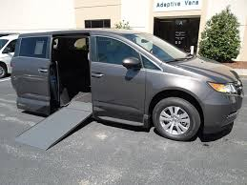
Ryan’s Driving Story

Slide 20
Question and Answer Session
We want to hear from you!
Please type a question in the chat box and we will try our best to answer!
Notes:
Note, image was derived from the stock images of the PPT.

Slide 21
Upcoming Webinar
January 9, 2024: 3:00 - 4:00 PM EST
Presenters: Cheryl Mitchell, AbleGamers
Register: https://bit.ly/DETAC-CoP-Jan-9-2024

Slide 22
TASH Conference Presentations
Come Check us Out!
Date: November 30, 2023
Location: Hyatt Regency, Baltimore, MD
Presentation Name:
The National Landscape of Subminimum Wage, Implications and Recommendations to Elevate CIE
The Intersectionality of Person-Centered Planning and Employment

Slide 23
DETAC offers free technical assistance!
Submit your request to the: on-demand TA request page
Reach out by emailing: AoDemploymentTA@gmail.com
Reach out!

Slide 24
DETAC Contact Information
Email: AoDemploymentTA@gmail.com
Website: https://aoddisabilityemploymenttacenter.com
DETAC Publications: https://aoddisabilityemploymenttacenter.com/detac-publications/
thanks for
stopping by!

